Slide 1
Web Api Versioning
Sarita Lad
DATE

Slide 2
Web API Versioning Strategies
Web API Versioning is required as the business grows and business requirement changes with the time. As Web API can be consumed by multiple clients at a time, Versioning of Web API will be necessarily required so that Business changes in the API will not impact the client that are using/consuming the existing API.

Slide 3
Web API Versioning Ways
Web API Versioning can be done by using the following methods:
URI
QueryString parameter
Custom Header parameter
Accept Header parameter

Slide 4
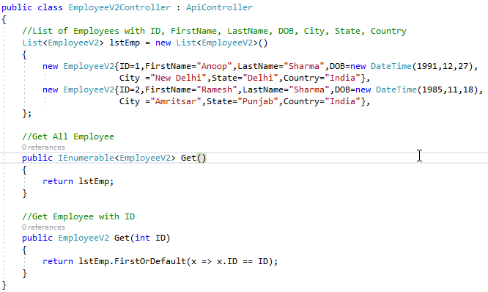
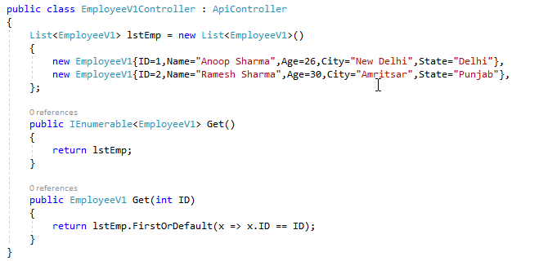
Web API Versioning using URI
In this method, Web API URI is changed with the help of routing and is more readable. Let’s say, we have an existing running API in which one URI returns some response. All Clients are consuming the same API and one client wants some changes by requesting to add new properties. With Versioning, we can achieve the same without breaking the existing API flow. In this case, Web API Versioning using URI is one of the best ways to achieve the same.

Slide 5
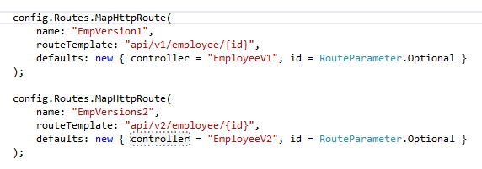
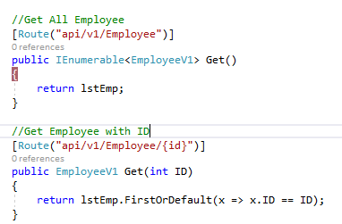
We can also use attribute-based routing for URI based API Versioning.

Slide 6
Required Packages for API Versioning
PM> Install-Package Asp.Versioning.Mvc
PM> Install-Package Asp.Versioning.Mvc.ApiExplorer

Slide 7
Thank You

